Slide 1
Objective:-
This Project aims to develop an essential online leave management system for the organization. This system automates the workflow of leave applications and their approvals.
The Leave Management System application will reduce paperwork and maintain records more efficiently.

Slide 2
Leave Management System
We have created Leave management system for Employee and Admin In which employees can apply leave on from their dashboard and admin can manage it easily and can Approve/Reject it on specific reasons.
By Team-2:-
Priti Sharma(Frontend)
Shashank Dubey(Backend and DB)
Nikhil Kumar(Backend)
Falak Chhabra(Testing and DB)
Abhijeet Rajput(Backend and Testing)

Slide 3
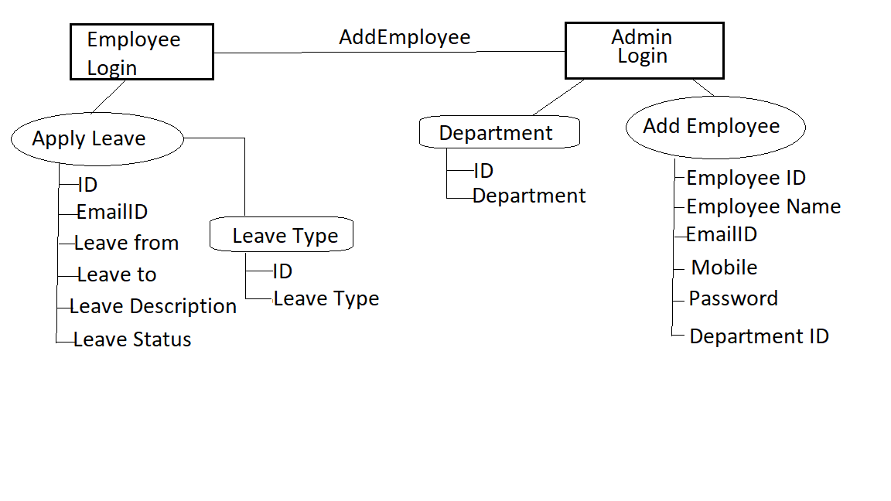
Database Schema:-

Slide 4
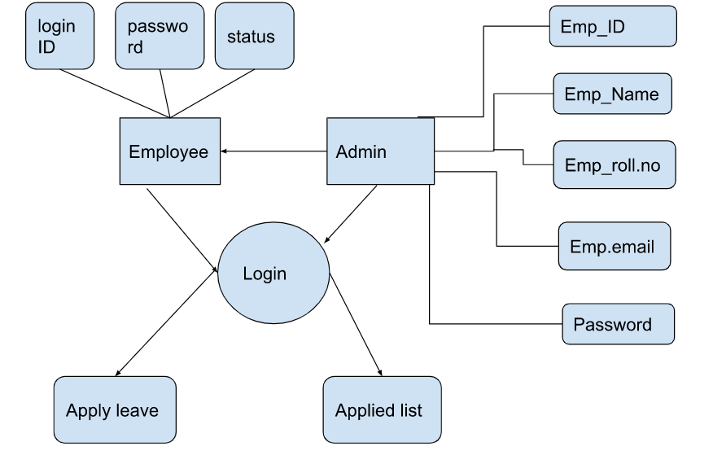
ER- Diagram:-

Slide 5
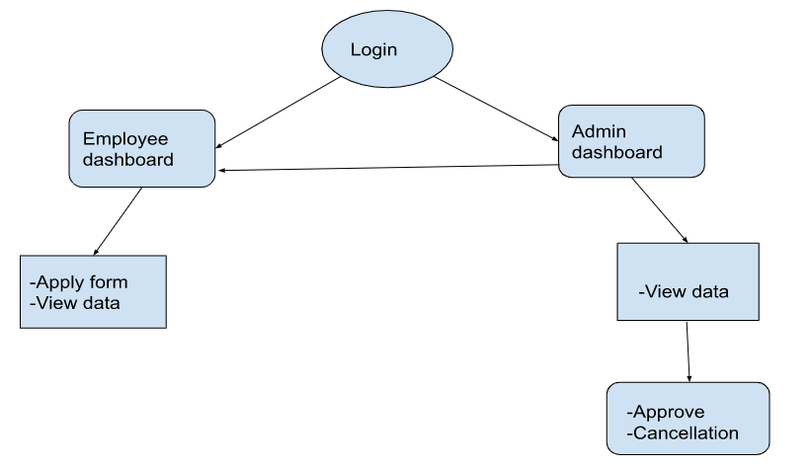
Data Flow Diagram:-

Slide 6
Thank You

